Slide 1


THE UNIVERSITY OF ARIZONA – Office of the Provost
Student Services & First Year Fee
Notes:
Hello everyone,
I am happy to welcome you to this training session as we gear up for an exciting shift in our project application process. As mentioned in my November 30th email, we have transitioned to AZ Cultivate for our FY25 cycle of funding for SSF and FYF, and today's session is designed to share our upgraded platform. AZ Cultivate will be an improvement and will also help both SSF and FYF Boards in their review process as well as streamline everything in one place for you.
Change is inevitable and is an adjustment and we want to ensure that you are well-prepared and comfortable as we navigate this next chapter together. We hope after this session you feel that the application process is more accessible and efficient for all.
During this training, we will walk you through the new features and our goal is to make this transition as seamless as possible, allowing you to focus on what matters most – preparing and submitting your project proposals.
As we explore the exciting functionalities of the new website today, we encourage you to ask questions, share your thoughts and provide any feedback.
New website starting with the FY25 Funding Cycle moving forward
Current Projects will submit progress reports on the old website for all of FY24.
FY25 Fully up and running on the new website
Historical info will remain on old website – as archive

Slide 2
We respectfully acknowledge the University of Arizona is on the land and territories of Indigenous peoples. Today, Arizona is home to 22 federally-recognized tribes, with Tucson being home to the O’odham and the Yaqui. Committed to diversity and inclusion, the University strives to build sustainable relationships with sovereign Native Nations and Indigenous communities through education offerings, partnerships, and community service.
Notes:
Read - ALLY

Slide 3

Panelists
Office of the Provost:
Nina Bates, Director of Ops and Strategic Initiatives
Scott M Norris, Senior Director, Finance & Administration
Allyson McAdams, Manager of Finance and Administration
Lin Huang, Financial Coordinator
Meeting Notes
Please ask questions at the end of the presentation by raising your hand or submitting your questions in the Q & A at the bottom of your screen.
The webinar recording and presentation materials will be shared after the meeting.
Notes:
ALLY

Slide 4
Topics to cover
History of the Fees
What's Changed
Application Process via AZ Cultivate
Website Navigation
Questions
TODAY'S
PRESENTATION
Notes:
ALLY
New website starting with the FY25 Funding Cycle moving forward
Current Projects will submit progress reports on the old website for all of FY24.
FY25 Fully up and running on the new website
Historical info will remain on old website – as archive

Slide 5
History of the Student Services Fees
The SSF fee is $142.50 per student, per semester, (prorated based on units enrolled) and is paid by all main campus UArizona students. Online and CAST do not pay these fees. The fee is split and $75 is managed by the Student Services Fee Board. The remaining portion of the fee supports the Student Union.
The First Year Student Fee is designed to fund programs and projects targeting First year student's interests. The fee is $10.00 per semester and is for all 1st year students.
impact
Notes:
SCOTT SLIDE
The SSF was approved by ABOR in 2009 and fiscal year 2010 was the first-year fees were collected.
It was originally $40/semester and increased to $75/semester in the Fall of 2017. The fee will increase again in the Fall of 2022 to $142.50, but the additional fee revenue of will be exclusively supporting the Student Union.
The fee with a Student Board was established at a time of substantial budget cuts. The University requested, and had student support for this fee, because students have a voice in how the fee is allocated.
Fee is paid by most, but not all UA students.
Always keep in mind that this is student money.
Our goal has always been - transparency. For 3 reasons:
We want any interested student to be able to understand how their fees are used.
Improper use of student fees or large balances associated with student fees can result in bad press for the University.
First Year Fee was formerly called the Freshman Fee. It is charged to first year students based on the status of completed units. Projects are designed to support First Year Students.
Started at the same time as SSF
Total funds to allocate are $100- $130K each year. Be mindful of this total when submitting requests.
Applications in February with review in March.

Slide 6
What has changed?
New application process via AZ Cultivate for FY25 funding and moving forward https://academicadmin.arizona.edu/student-services-fee
FY25 Application https://arizona.infoready4.com/#applicationGrid/1924331
Funding Minimums and Maximums
Letter of support from unit leader must be provided as part of supporting documentation
*Dedicated email address- SSFandFYF@arizona.edu*
Notes:
Ally Slide

Slide 7

New Website Home Page
Student Services Fee
https://academicadmin.arizona.edu/student-services-fee
SSF FY25 Application
https://arizona.infoready4.com/#applicationGrid/1924331
*CHROME – preferred Browser*
First Year Fee
https://academicadmin.arizona.edu/first-year-student-fee
The application process for First Year Fee will be the same process, applications will open for FY25 funding on 2/1/2024 and close on 3/11/2024 at Noon.
Funding Range
Student Services Fee
Minimum $10,000
Maximum $400,000
First Year Fee
Minimum $5,000
Maximum $50,000
Notes:
Scott slide
Note on minimums - If we have an exception, it could be recommended by the Board then approved by the Provost.

Slide 8
Unit Leader Letter of Support required
Beginning with the FY25 application process,
every new proposal application submission
must include a one page PDF memorandum from the leader of the respective
unit, affirming their awareness of the
submission of the project.
Subject: Director Approval for New Proposal Submission
*Should be in a memo format and include:
Project name
Brief project description
Amount and years of funding requested
Confirmation of Director’s support
Notes:
ALLY

Slide 9
Proposal Submission changes for New SSF & FYF Projects.
Question responses will have a character Limit of 250 words maximum or about 1,500 characters with space
You will be able to attach up to 2 pages of additional information in a PDF format if you would like to provide more information about your project.
Applicant Questions
Project Description, which includes a Statement on how the project/program supports or enhances the student experience and positively impacts student life.
Reason(s) for creating and/or maintaining the project/program.
The number of students who will be directly impacted by the project/program.
Statement on how the success of the project/program will be assessed.
Statement on how the project/program will be sustained beyond the duration of the SSF and FYF funding
Notes:
ALLY
Student Services Fee Proposals are submitted by various Departments under Office of the Provost
Proposals are submitted using the online form on the SSF website. Submission period is December thru early January.
All Proposals submitted will include a budget spreadsheet as an attachment. The updated budget template is downloaded from the SSF website. Budget expense types are in accordance with University budget categories. Budgets narratives clearly support the budget data.
Project Directors must approve project submission and beginning in FY23, Fiscal Officers will be required to sign off on any required budget report submitted to SSF before submission.
The SSF Board reviews all proposals and votes to approve or deny each proposal request for funding. Funding can be full or partial, and the term of project can be 1-3 years ( for SSF projects) . Total dollar amount of proposals funded are based on a projection of funds available.

Slide 10
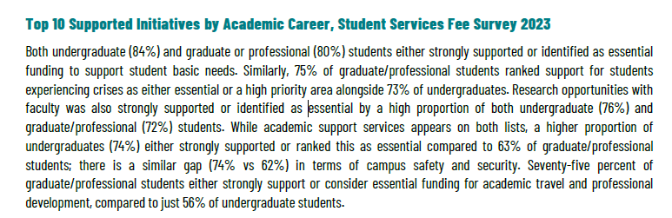
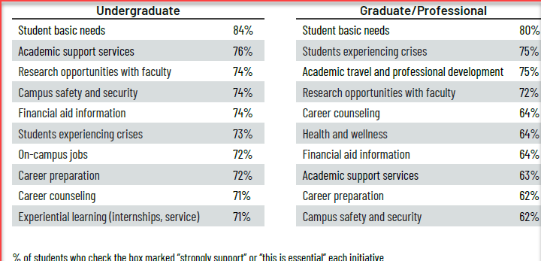
Notes:
Ally Slide
Top 10 Priority breakouts by academic careers

Slide 11
Application Process & New Website Navigation
Nina Bates - Developer
Notes:
ALLY INTO - NINA

Slide 12
THE UNIVERSITY OF ARIZONA – Office of the Provost
Questions!
Notes:
THANK YOU for ATTENDING!

