Slide 1


THE UNIVERSITY OF ARIZONA – Office of the Provost
Student Services Fees

Slide 2
We respectfully acknowledge the University of Arizona is on the land and territories of Indigenous peoples. Today, Arizona is home to 22 federally-recognized tribes, with Tucson being home to the O’odham and the Yaqui. Committed to diversity and inclusion, the University strives to build sustainable relationships with sovereign Native Nations and Indigenous communities through education offerings, partnerships, and community service.

Slide 3

Topics to cover
History of the Fees
Fiscal Officer & Project Manager
Application Process
Website Navigation
Important Reports, Budget Templates and Dates
Analytics Budget Reports
Questions
TODAY'S
PRESENTATION

Slide 4
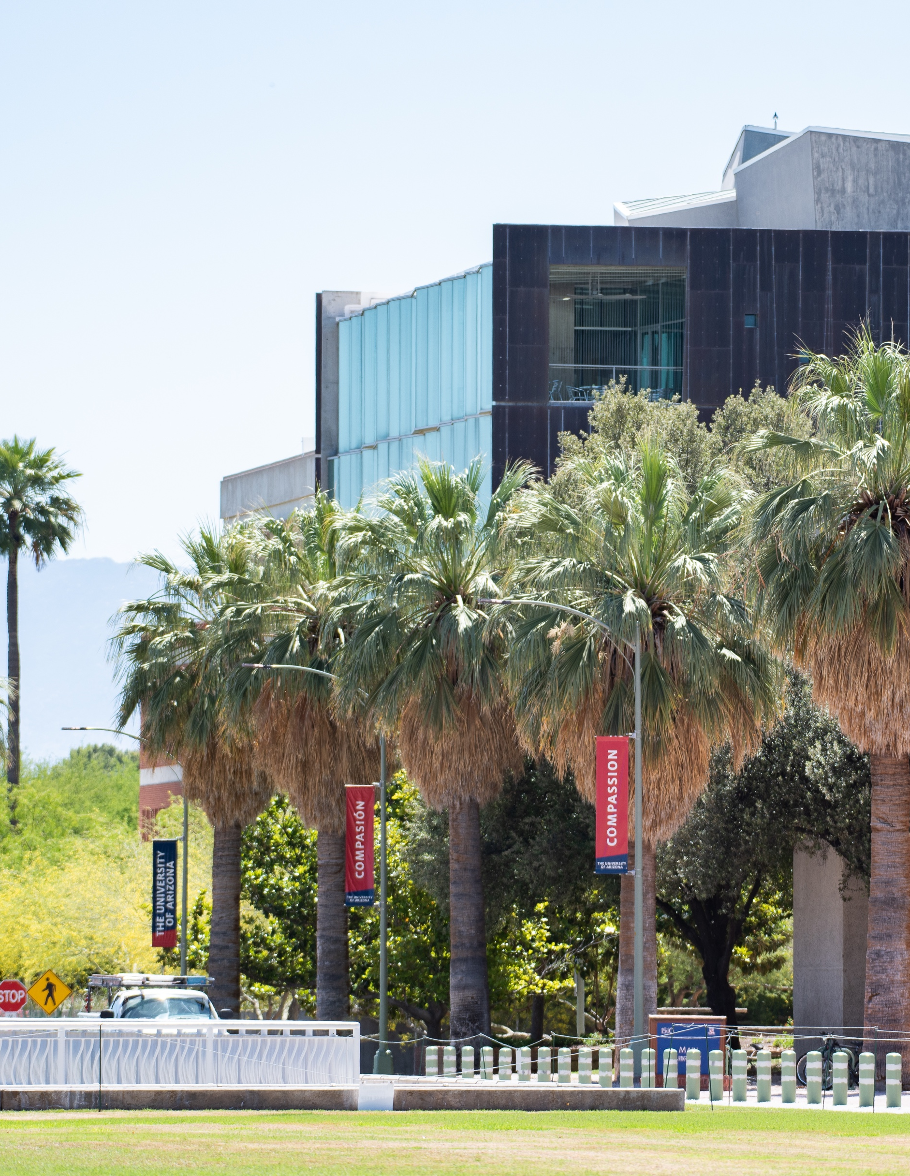
SSF Procedural Process Objectives
.
Create Transparency and Clarity for Allocations, Reporting & Auditing.
Consistent reporting format.
Monitor the Progress of Projects.
Organize Project Data
The University of Arizona
Notes:
The procedures outlined will achieve the following objectives:
Create transparency for students and administration of SSF project allocations and reporting.
Present financial reporting for all proposals & funded projects in a consistent format.
Create alignment with Project Manager, Fiscal Officer & Director for the project plan, funding, and reporting requirements.
Monitor the progress of the projects by periodically reviewing the Progress Reports and University Financial Records for required data and adherence to budget.
Organize Project Data - each project; Application, Revisions to Applications, Progress Report, PAR, Funding Notification Letter, and Budget will be accessible on the SSF website.

Slide 5
History of the Student Services Fees
The SSF fee is $142.50 per student, per semester, (prorated based on units enrolled) and is paid by all main campus UArizona students. Online and CAST do not pay these fees. The fee is split and $75 is managed by the Student Services Fee Board. The remaining portion of the fee supports the Student Union.
The First Year Student Fee is designed to fund programs and projects targeting First year student's interests. The fee is $10.00 per semester and is for all 1st year students.
Notes:
The SSF was approved by ABOR in 2009 and fiscal year 2010 was the first-year fees were collected.
It was originally $40/semester and increased to $75/semester in the Fall of 2017. The fee will increase again in the Fall of 2022 to $142.50, but the additional fee revenue of will be exclusively supporting the Student Union.
The fee with a Student Board was established at a time of substantial budget cuts. The University requested, and had student support for this fee, because students have a voice in how the fee is allocated.
Fee is paid by most, but not all UA students.
Always keep in mind that this is student money.
Our goal has always been - transparency. For 3 reasons:
We want any interested student to be able to understand how their fees are used.
Improper use of student fees or large balances associated with student fees can result in bad press for the University.
Auditor in a meeting yesterday stressed the importance of transparency in what we do and how we do it with student fees.

Slide 6





















Native Rise
Notes:
SSF allocates approx. 3 million each year to a wide variety of Departments & Programs
Student Service fee Dollars touch a broad range of students here on Campus.
**A SSF Survey is conducted every 2 years to collect student feedback as to how Students want to see their dollars spent. The survey allows the SSF board to prioritize based on students wants and needs. Student Services Fee Administrative Marketing pays for all costs associated with this survey**.

Slide 7

Proposal Submission for New Projects
SSF & FYF Proposals are submitted by varied Office of the Provost Departments online through the SSF website in December thru early January. Submitted budgets must be vetted and signed off by the Fiscal Officer.
All Proposals submitted will include a written project narrative & budget spreadsheet as an attachment. The current Fiscal Year budget template is downloaded from the SSF website on Arizona Cultivate. Budget expense types are in accordance with University budget categories. Budget data should support the narrative detail.
The Board reviews all proposals and votes to recommend funding for each proposal.
Notes:
Student Services Fee Proposals are submitted by various Departments under Office of the Provost
Proposals are submitted using the online form on the SSF website. Submission period is December thru early January.
All Proposals submitted will include a budget spreadsheet as an attachment. The updated budget template is downloaded from the SSF website. Budget expense types are in accordance with University budget categories. Budgets narratives clearly support the budget data.
Project Directors must approve project submission
The SSF Board reviews all proposals and votes to approve or deny each proposal request for funding. Funding can be full or partial, and the term of project can be 1-3 years ( for SSF projects) . Total dollar amount of proposals funded are based on a projection of funds available.

Slide 8
Next Steps
The Board provides the Provost with recommendations for funding. Once approved the Board’s Advice Allocation memo is uploaded to the Student Services Fee Resources or First Year Fee Resources page
A summary of approved projects with pertinent details will be uploaded to the SSF website for viewing.
By the end of July project budgets will be available for review in Analytics. Please check your Analytics budget and transfer of funds to be sure all aligns.

Slide 9
Project Revisions
When a project is funded for less money or fewer years than requested a project revision Word document and budget must be completed and returned.
SSF administration will send out those documents to the Project Manager with a deadline attached for them to be returned. There will be a budget template and a word document to fill out and return.
Notes:
When a SSF project is funded for less money or fewer years, we ask the project manager to fill out and return a word document describing the impact the reduction inf funding has on the project.
We may require and request a budget revision template as well.

Slide 10

Next Steps, continued
Current FY Projects
Fiscal Officers should be reviewing late May.
Review budget categories and transfer out any expenses to ensure the project expenses align with the budget prior to fiscal year end in June.
Progress Reports are due
Dec 31 & Aug 31
*Unfavorable variances could impact the Board’s willingness to fund future projects.
Notes:
For current projects - prior to year-end, ( May - June) all SSF accounts will be reviewed to ascertain that expenditures are in alignment with the budget.
Fiscal Officers should be reviewing their account activity throughout the fiscal year and a more detailed review of the projects in May,
to ensure all inappropriate expenses are moved off prior to year end.
Year-end Progress Reports are due on August 31st.

Slide 11

Student Services Fee Website
Navigate to the Student Services Fee & First Year Fee Website using the following address:
https://academicadmin.arizona.edu/student-fees
*CHROME – preferred Browser*

Slide 12
Reminders
Unit Leader Letter of Support required
Beginning with the FY25 application process, every new proposal application submission
must include a one-page PDF memorandum from the leader of the respective unit, affirming their awareness of the
submission of the project.
Student Services Fee
Minimum $10,000
Maximum $400,000
First Year Fee
Minimum $5,000
Maximum $50,000

Slide 13
Subject: Director Approval for New Proposal Submission
*Should be in a memo format and include:
Project name
Brief project description
Amount and years of funding requested
Confirmation of Director’s support

Slide 14

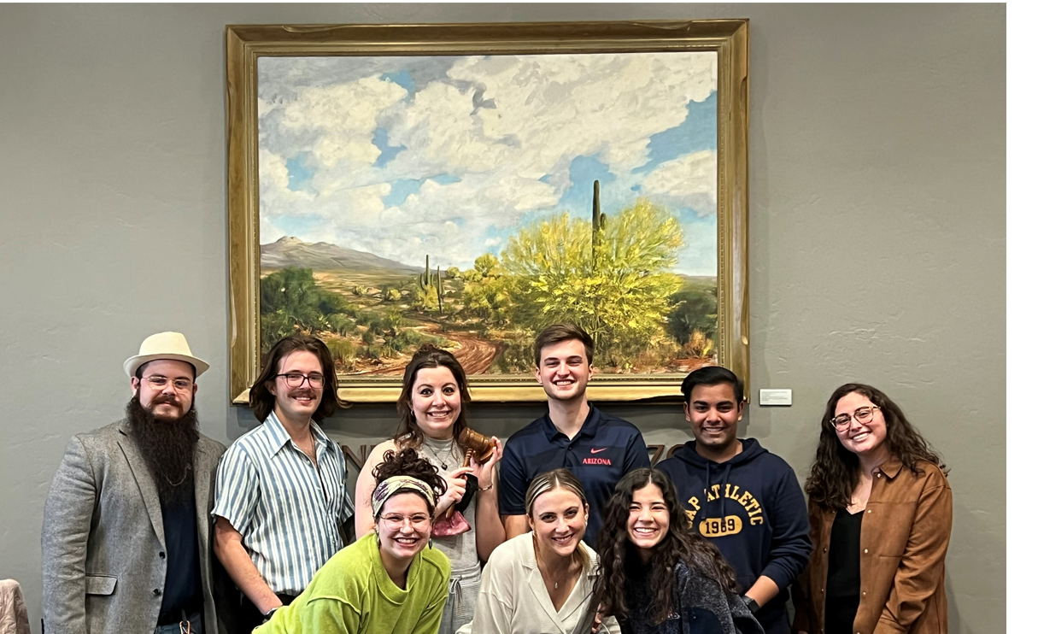
SSFAB Board Members
Notes:
I want to take a minute to acknowledge the work these students do.
Meetings are 3-5 or later, on Friday afternoons. Prior to each meeting the students spend many hours preparing for the meetings.
They recognize the time and effort you put into proposals.
They care very deeply about this campus
Making decisions about what to fund is truly difficult for them.

Slide 15
Student Services Fee Advisory Board Positions -11
First Year Student Fee – Advisory Board Positions – 9
Board Positions
2- Co-Chairs – These individuals oversee the Board meetings and meets periodically with the Board advisors
Secretary – Oversee the collection of notes and consolidating the records each Board member is responsible for and sending these notes out to the group.
Composition of the Board
2 ASUA appointed representatives
2 GPSC appointed representatives
5 undergraduate students from the student body at-large
2 Graduate students from the student body at-large
First Year Fee Board members are nominated and/or appointed
Notes:
I’ll take a few minutes to explain the structure of the Board.
Board consists of 11 students
appointed students from GPSC and ASUA and
students from the student body-at-large who apply for a position with an application and interview process.
From the Board - Leadership Positions are established. Usually, we have 2 co-chairs to oversee the Board and a secretary.
First Year Fee Board is a mini–version of SSF.
9 Boar members
4 from SSF also serve on the FYF Board
5 First Year students. We will discuss the FYF a bit more in some upcoming slides.

Slide 16
Roles & Responsibilities
The Role of the SSFAB is to:
• Act as the deliberating body on the use of the Student Services Fee (SSF) and provide advice and recommendations to the Provost on how to allocate the SSF based on the requests that come before the SSFAB and the results of the bi-annual survey.
The Responsibilities of the SSFAB are:
• Represent the Student Body of the University of Arizona
• Maintain an unbiased approach to all decisions
• Understand the Departments under the Office of the Provost and their needs
• Recommend and advise on the use of the Student Services Fee
• Understand University-wide budgets and structure
• Outreach to Students and Directors within Office of the Provost
• Meeting Requirements
o Appropriation Meetings
o Additional SSFAB meetings as necessary
• Help define the SSFAB
• Attendance at all Trainings & Retreats- Board Meetings are held on Jan-April on Fridays 3- 5pm.oard Meetings
Notes:
This slide provides an example of information shared with the Board at the Fall training. Being a Board member is a rewarding opportunity for students.
We have always appreciated having Board members who come from departments that receive SSF funding. Sometimes they are even paid from SSF projects. Thanks for recommending this opportunity to your student employees and other students you engage with on campus. When we send a notification that we are recruiting Board members, we appreciate you encouraging students to apply.

Slide 17
USE IT OR SAVE IT!
Student Fee
Spending Guidance
Any unused Funds are returned to the Board
No FUNDS are EVER LOST
Be a good steward with Student Fee dollars
Notes:
Student Fee Spending Guidance
The funds allocated to your project are student dollars. Please always be mindful of how they are spent. I like to remind managers & fiscal officers of the newspaper test. By this I mean - If an expense associated with your project and supporting documentation was reported on the front page of the newspaper, could you support and stand behind how the fee dollars you are responsible for were spent?
If you have achieved your projects goals and have money left at the end of the year – that is AWESOME! The unused funds go back to the Board to allocate the next year.
I don’t like to hear anyone say, we need to find a way to use the total project allocation, so we don’t lose money. No money is lost – it gets repurposed the next year.
Following University Policy Matters – Recent Audit meeting there was a question about food brought to campus for a business meeting. Do you all know that you are required to use the Student Union for food or request a waiver if you plan to spend more than $750 for food?
We all know students who struggle to pay their university bills – you support them by spending the fee dollars they pay wisely.

Slide 18
FIRST YEAR STUDENT FEE
The First Year Student Fee is designed to fund programs and projects targeting First year student's interests and aligning with the Office of the Provost's goal of creating an exceptional student experience at UA. The Arizona Board of Regents approved this mandatory fee in December 2008 for implementation in Fiscal Year 2009-2010.
The fee is $10 per semester for all First Year students. Previously funded projects include Bear Down Camp, Family Weekend, SafeCats and Finding Community Welcome. Funded programs and projects target aspects of the first-year student experience.
Applications for project proposals are typically submitted beginning in February and review of proposals begins in March. impact on students.
First Year Student Fee

Slide 19

First Year Fee Board
One of the SSFAB Co-Chairs serves as the Chair for the First Year Student Fee Board(FYSFB). The remainder of the board members are appointed from ASUA and RHA. These meetings are also held on Fridays. FYSFB is a very mini version of SSFAB.
First Year Fee project details
Projects are only for one year.
NO Program Alteration Request ( PARS)
Notes:
This Board also meets on Friday afternoons, but only in the Spring semester.
Mini-version of SSF
Differences:
Projects are only one year
No Program Alteration Requests are allowed.

Slide 20
Spreadsheets & Summary
2 Yearly Reports
SSF Project Reporting
Notes:
Projects are required to submit Progress Reports twice a year, mid-year due Dec 31st and end-of-year due Aug 31st.
These reports are frequently reviewed by the Board as they work to make funding decisions.
Reporting includes – written report describing the activity of the project and a spreadsheet comparing the budget data to actuals for the given time period.

Slide 21
Progress Reports & PARS are submitted on the Progress Reports and PARS page.
  https://academicadmin.arizona.edu/progress-reports-and-pars

Slide 22
Interim Progress Report – 12-31
Program Manager fills out the written portion of Project Scope, Outcomes & Student Response on the website under their project.
The project header information and the Budget column of the budget template have been completed for you.
We enter actuals data from UAccess Analytics, as of 11/30, in the column labeled Actual YTD (column G). For those projects that have multiple categories in their operations budget, the total year-to-date expenditures have been combined. Please adjust the operations section to reflect the expenses in each category. Enter data in the column labeled Projected Exp (column I). This amount represents planned expenditures for the remainder of the fiscal year (through June 30th).
Notes:
Interim Progress Reports are due on December 31st.
The project header information and the Budget column have been completed for you.
We will enter actual data from UAccess Analytics, as of 11/30 in the column labeled Actual YTD . For those projects that have multiple categories in their operations budget, the total year-to-date expenditures have been combined. Please adjust the operations section to reflect the expenses in each category. Enter data in the column labeled Projected Exp (column I). This amount represents planned expenditures for the remainder of the fiscal year (through June 30th).
The reports will be reviewed by SSF ADMIN staff to ensure that all required data is included.

Slide 23
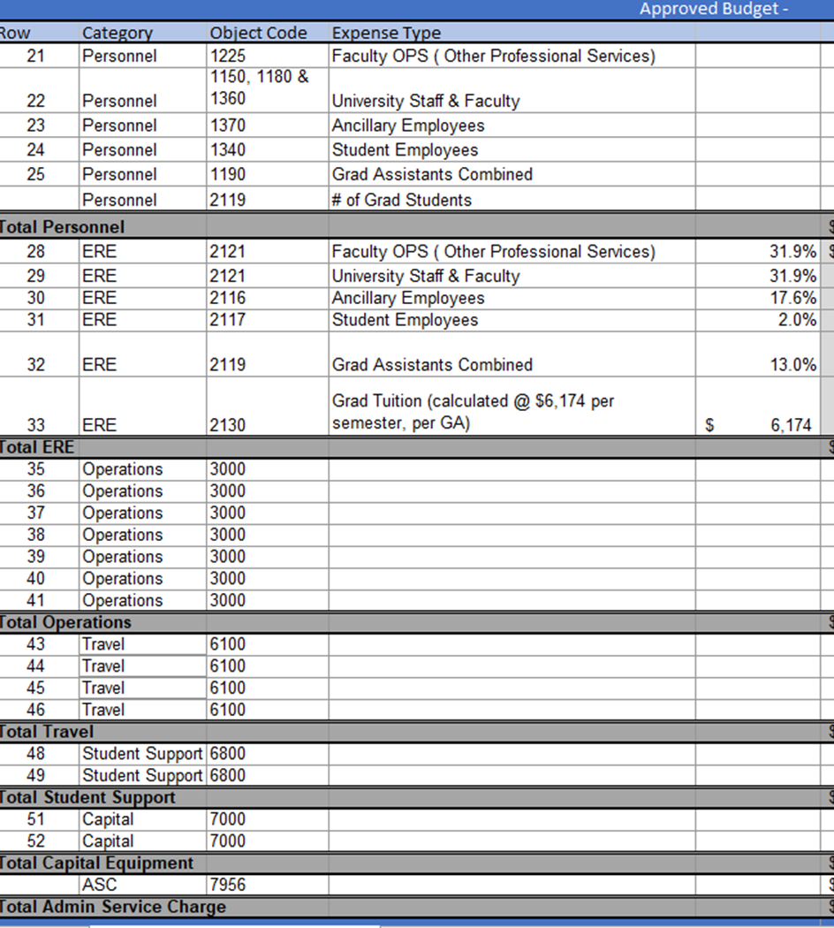
Personnel
ERE
Operation’s
Travel
Student Support
Capital Expenses
ASC
Budget Spreadsheet Categories
Notes:
The Project Budget is an excel spreadsheet providing a detailed project budget by object code categories. The budget mirrors the Income and Expense report.
The typical budget categories are Personnel (broken down by type)
Operations
Equipment
Travel
Student Support
Capital – only to be used if the item is over $5K – typically we do not see capital expense on SSF projects.
ASC

Slide 24
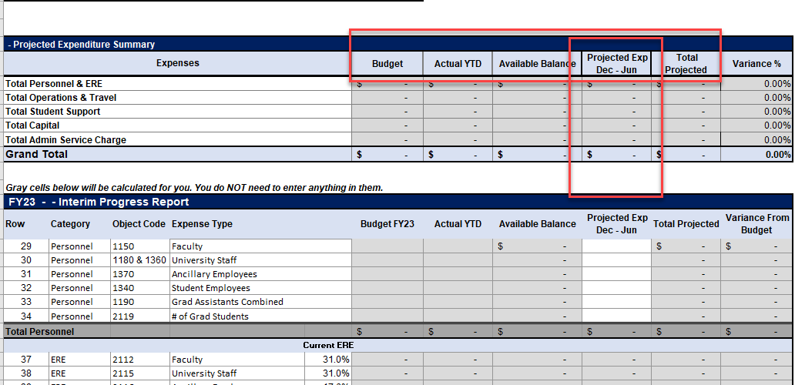
Interim Progress Report Spreadsheet
Notes:
The project header information and the Budget column have been completed for you.
Enter actual dollar amounts
Actual data from UAccess Analytics, as of 11/30 has been entered in the column labeled Actual YTD (column G). For those projects that have multiple categories in their operations budget, the total year-to-date expenditures have been combined together. Please adjust the operations section to reflect the expenses in each category. Enter data in the column labeled Projected Exp (column I). This amount represents planned expenditures for the remainder of the fiscal year (through June 30th).

Slide 25
Final Year-end Progress Report-
The Final Budget Spreadsheet is designed to provide data in a format consistent with UAccess Analytics.
Program Manager fills out the written portion of Project Scope, Outcomes & Student Response on the website under their project.
The project header information and the Budget column have been completed for you.
You will enter actual dollar amounts from UAccess Analytics, as of end of fiscal year, in the column labeled Actual YTD.
Due 8/31.
Notes:
Year-end Progress Reports are due on August 31st. The reports will be reviewed by SSF Administrative staff to ensure that all required data is included. These reports include:
Spreadsheet budget template which will be sent out to each project manager.
Narrative summary of project and the project’s impact on students on the SSF Website.
Attachment of relevant supporting documents.
A budget spreadsheet attachment detailing, budget, YTD expenses, and variance from budget.

Slide 26
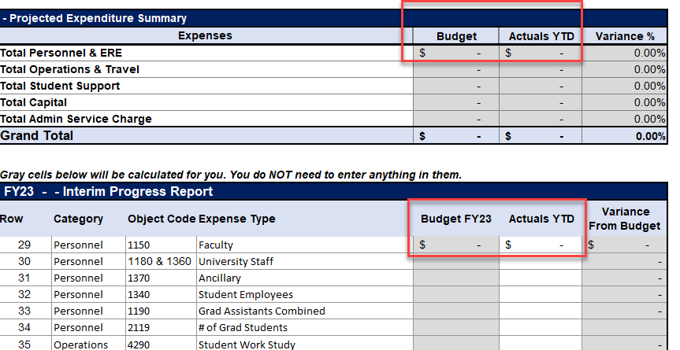
Final Progress Report Spreadsheet
Notes:
This is the budget SS mentioned in the previous slide.
A budget spreadsheet attachment detailing, budget, YTD expenses, and variance from budget. An explanation of expense categories and/or total project exceeding the budget is required. Spreadsheet template is provided to each project manager.

Slide 27
PARS
Is a Program Alteration Request required to adjust your project?
Pars are reviewed at SSFAB Board meetings on Fridays.
Submit your PAR no later than Wednesday of the week the Board is meeting.
Describe the changes clearly.
Provide the PAR Template vetted by your Fiscal Officer.
Refer to the PAR Flowchart on the website at
https://academicadmin.arizona.edu/progress-reports-and-pars
Notes:
We all know that you submit proposals far in advance of receiving funding. Things can change. If a project determines a need to spend funds differently than budgeted, a Program Alteration Request (PAR) may be required. It is the responsibility of the Project Manager and Fiscal Officer to be familiar with these requirements and ensure the expenses charged to the account are in alignment with the Board approved budget for the project. If you are uncertain if a change in spending requires approval, ask questions before spending. In this slide there is a link to a PAR flowchart to help you determine in a PAR is necessary.
Some changes in spending always require a PAR - for example:
• Spending wages allocated for students (graduate, or undergraduate) for any other personnel type, like University Staff., or vice versa.
• Spending in a different budget category than identified in the project budget (unless specifically authorized in the Award Letter); for example:
Funds are budgeted for Operations, and you want to provide student awards instead.
Some changes in spending do not require a PAR - for example:
Change in student hiring mix - hiring undergraduates instead of graduates (just be aware of ERE difference)
Change between Operations and Travel – we treat these budget categories as interchangeable.
If you are ever uncertain about whether a PAR is needed, please ask. Save yourself and the Board time. Always ask your fiscal officer to review a PAR request before submitting.
The Board always considers whether the PAR request aligns with the original project plan when deciding if a change is appropriate.

Slide 28
Recommended Reports
UACCESS ANALYTICS

Slide 29
Budget Hybrid Style Accounts- SSF Accounts will be in budget style account.
This type of account has cash money, but also has designated budget with a plan for how funds will be spent in the fiscal year.
Reports to use for tracking:
Analytics>Financials>General-Financial Management>Current Account Balances
Analytics>Financials>General-Financial Management>Income & Expense Reports
Analytics>Budget>Line Management>Budget Balances>Current & Next Year Budget -Balance Available
Analytics>Budget>Line Management>Budget Balances>Current Next Year Budget
Notes:
Your SSF account is what we refer to as a budget hybrid account. This means it has cash transferred to it and it also has a budget. We’ve provided the path to some useful reports and will spend a few minutes looking at them, but this is not intended to be a deep dive in Analytics reports, we just want to provide an overview of what is available.

Slide 30
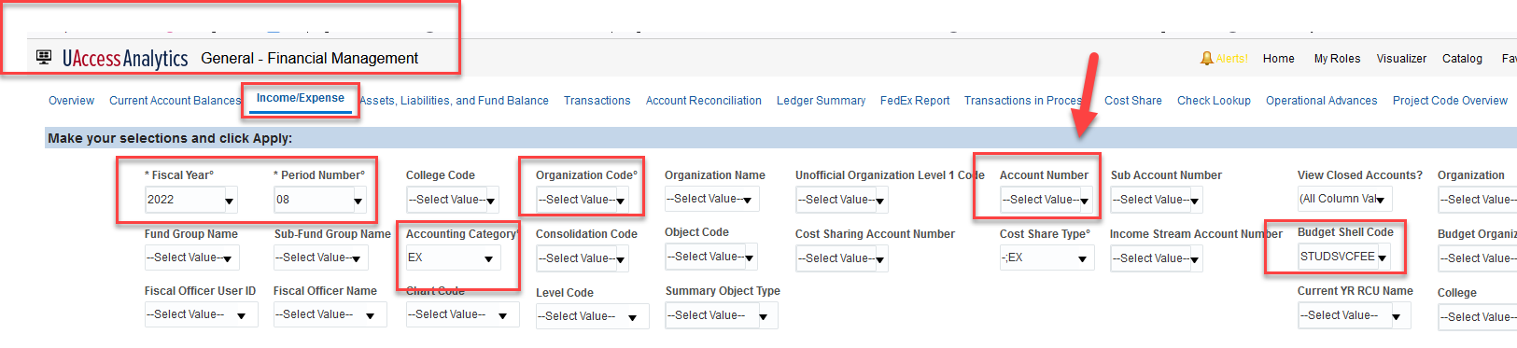
Income & Expense Report
Notes:
The Income and Expense report has a couple key fields you are probably familiar with that you need to enter data into in order to see a specific SSF account.

Slide 31
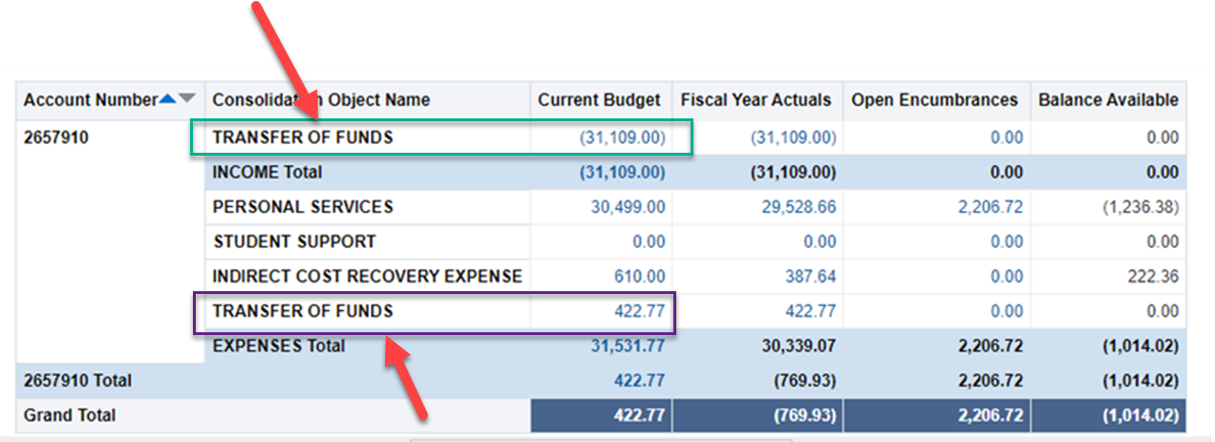
Income & Expense Report
Notes:
Once you have entered data into the Income and Expense Report criteria, you will see a report that looks like this. A couple items to note:
The Transfer of Funds line in the income category is your current year funding.
The Transfer of Funds in the expense category is for the return of funds that were unspent in a prior year.
Change the view on this report for show object codes to see how spending in budget categories aligns with the budget, and how much remains available.
We do repurpose SSF accounts if a department has a different project from one fiscal year to the next.
There are many other reports that can also be useful to review your account activity. If you need help understanding how to see what is available, please ask. We are happy to advise.

Slide 32
CATERING POLICY REMINDER https://policy.arizona.edu/business-and-finance/catering-and-food-service policy#:~:text=A%20Master%20Agreement%20must%20be,for%20retail%20sale%20on%20campus
Audit reports
    https://www.kuer.org/politics-government/2022-02-03/whats-my-fee-again-auditor-say-utah-college-charges-lack-accountability
    https://www.bizneworleans.com/audit-finds-several-issues-with-louisiana-state-university-system/
    https://www.azauditor.gov/reports-publications/state-agencies-universities/regents-boardarizona-state-university-northern
Notes:
Audit reports
https://www.kuer.org/politics-government/2022-02-03/whats-my-fee-again-auditor-say-utah-college-charges-lack-accountability
https://www.bizneworleans.com/audit-finds-several-issues-with-louisiana-state-university-system/
https://www.azauditor.gov/reports-publications/state-agencies-universities/regents-boardarizona-state-university-northern
Catering policy reminder
https://policy.arizona.edu/business-and-finance/catering-and-food-service-policy#:~:text=A%20Master%20Agreement%20must%20be,for%20retail%20sale%20on%20campus

Slide 33
THE UNIVERSITY OF ARIZONA – Office of the Provost
Thank you!
Notes:
Slide #34
THANK YOU for ATTENDING!

